Slide 1
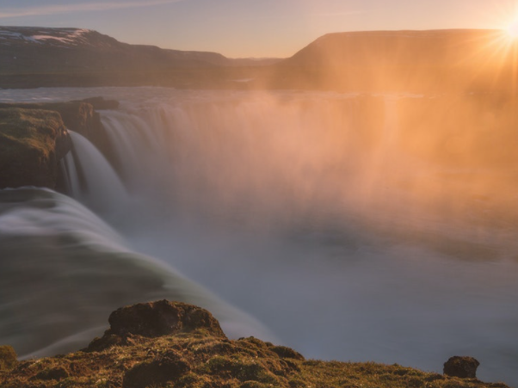
The great Switch

Slide 2

The Gospel of the Kingdom
Notes:
The United Church of God has a booklet titled The Gospel of the Kingdom of God. And this booklet goes through the doctrine of the Kingdom of God that is to come in the future, and both the promises of it that were recorded in the bible, and also to paint a picture of what it will be like at the start of the Millennium. I wanted to pull out a small section from this booklet and try to bring it to life a little bit more.
But first, I’d like to turn back to Matthew chapter 24. Matthew 24 talks about events leading up to the end time and Christ return, and how the stage will be set before His glorious Kingdom begins. In this chapter some of the issues that have plagued humanity in the thousands of years since the Garden of Eden are brought to life.

Slide 3
Matt 24:3-5
Matt 24:3 Now as He sat on the Mount of Olives, the disciples came to Him privately, saying, "Tell us, when will these things be? And what will be the sign of Your coming, and of the end of the age?"
4 And Jesus answered and said to them: "Take heed that no one deceives you.
5 "For many will come in My name, saying, 'I am the Christ,' and will deceive many.
Notes:
[SCRIPTURE]
Christ mentions that before His return, there will be religious deception. But, of course, we already experience this in some fashion right now. It’s been a problem since the beginning of man’s time on the earth and will continue to very end. Dropping down to verse 21.

Slide 4
Matt 24:21
Matt 24:21 "For then there will be great tribulation, such as has not been since the beginning of the world until this time, no, nor ever shall be.
22 "And unless those days were shortened, no flesh would be saved; but for the elect's sake those days will be shortened.
23 "Then if anyone says to you, 'Look, here is the Christ!' or 'There!' do not believe it.
24 "For false christs and false prophets will rise and show great signs and wonders to deceive, if possible, even the elect.
Notes:
[SCRIPTURE]
This religious deception and confusion all culminates together into widespread and nearly universal trickery leading up to Christ return. Now, religious deception has been a cornerstone of Satan’s attacks on mankind. He’s not only successfully created confusion within Christianity, but he’s also created hundreds or thousands of different religious ideas. And then, as if that wasn’t enough, Satan has constantly and continually pitted these various religions against one another. Conflict after conflict, throughout history has been with one false religion fighting against another false religion.
So when Jesus Christ returns to the Earth, it will be a remarkable feat to be able to straighten out all of the religious variants from one another and to show a true religion that has been largely hidden throughout time. And it will require the human beings remaining on Earth at the start of the Millennium, to switch religions. It will be a Great Switch.
Has such a thing ever taken place? Can we even fathom something like this happening? Has there ever been a time in history where a huge population voluntarily made a switch from one religion to another?

Slide 5
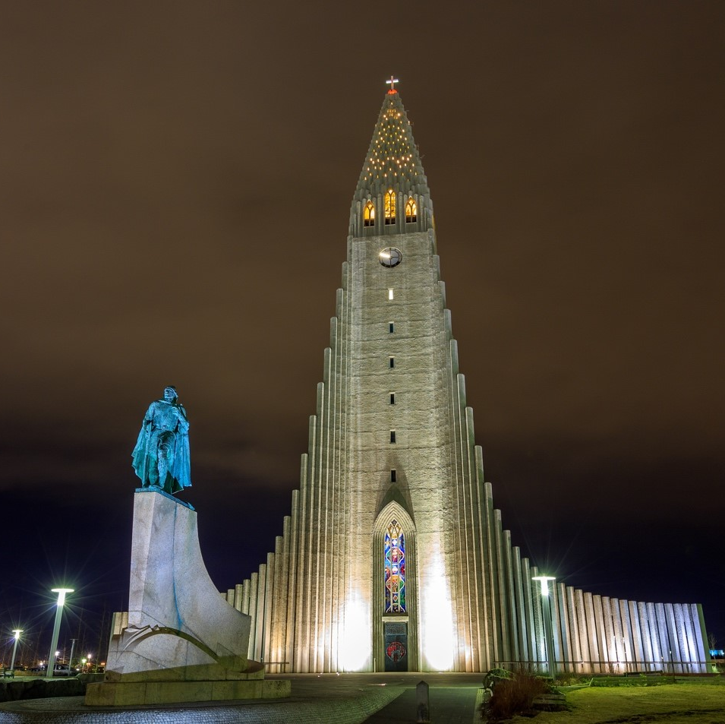
Hallgrimsk-irkja
Notes:
In the small island nation of Iceland, they have a unique building. I have a picture of it here. Sarah and I actually got to travel to this place, we went up in the top and took pictures all around. It feels miles higher than anything else around - purposely so. It’s a church, a Christian Lutheran church, right in the capitol Reykjavik
Like everything else in Icelandic, its name was largely not-pronounceable by mere humans like me and contains way too many “j”s and “k”s. But it’s a relatively famous church, and one that you’ve probably seen pictures of due to its unique design and architecture. It’s called Hallgrimskirkja (HALL-creams-kirk-yuh).
Construction started in 1945 and took 41 years to finish. Parts of the church were built some 75 years ago in honor of the 1,000th anniversary of Iceland’s parliament. 1,000 years ago, the nation of Iceland did something remarkable. It was a one-of-a-kind event that has never before occurred, and will likely never again happen. Until, that is, the Great Switch in the Millennium.

Slide 6
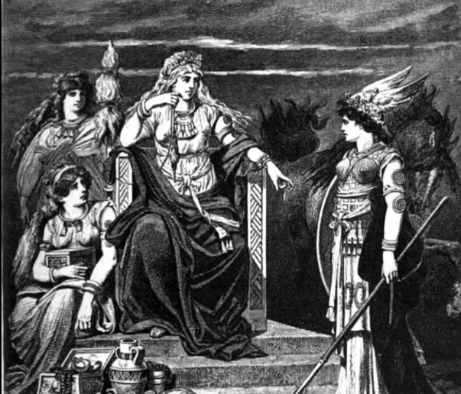
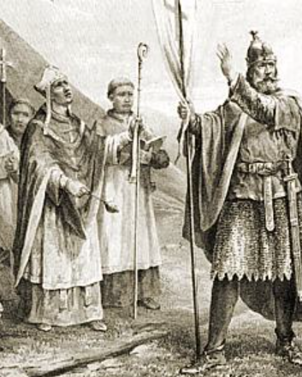
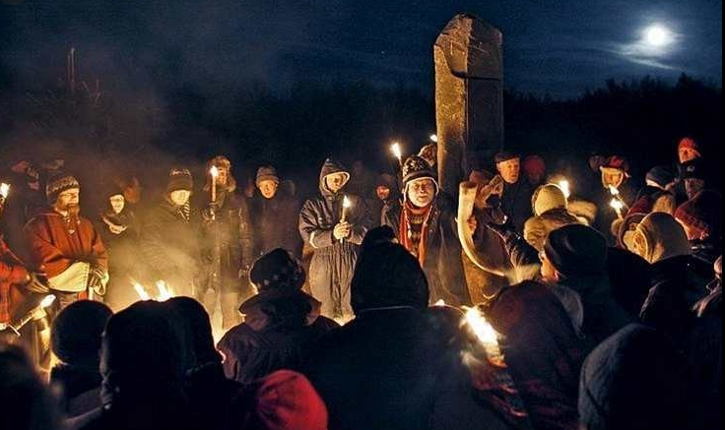
Notes:
In Iceland in leading up to 1000 AD we see strange situation brewing. There were a couple of different religious factions. They had some missionary presence that spread Christianity. However, the predominate religion was pagan based, including lots of worship of Norse gods, of which, you’d recognize from recent populate movies including names like Thor, Odin, Loki, etc. Lots of variations between these religions and all causing conflict between one another. As we approach 1000 AD, civil war was looming between all of these groups.
Just like many other points in history, it looked like conflict was inevitable. And the only way to settle the religious debate was to duke it out and let the most powerful decide the outcome. And then, of course, once they won – to force it upon the losing side.

Slide 7
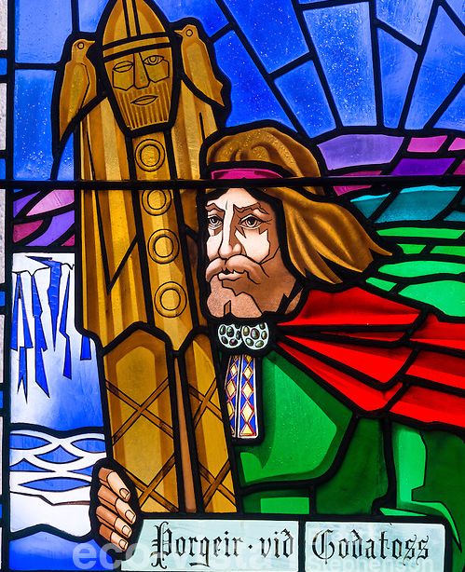
Thorgeir
Ljosvetningagodi
Thorkelsson
Notes:
But the history of Iceland took an interesting and unusual turn. As it reached a boiling point it was decided that the religious destiny would be decided by arbitration. The people selected a respected politician and a man of the law named, well, you can see his name on the screen. Let’s just call him Mr. T. He also happened to be a pagan priest, but he was an individual that all sides of the religious debates could settle on as the arbitrator. The religious sides brought forth their arguments and agreed to abide by the decision of this individual arbitrator. And after a day and a night under a fur blanket contemplating, he made his decision. He decided that the country was to become completely - Christian.

Slide 8
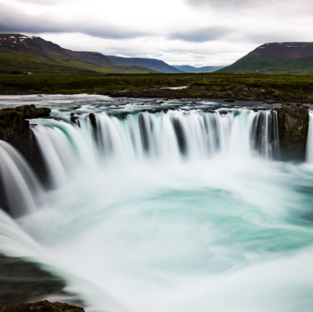
Godafoss
Notes:
He took his pagan idols and threw them into a large waterfall, now called the Waterfall of the Gods or Godafoss, and switched to Christianity himself. The rest of the people agreed to follow as they promised, and the problem of conflicting religions was solved and civil war was aborted. Those that were not Christian voluntarily became baptized and that was that.
It’s the only case on record, before or since, of an entire nation switching religions voluntarily, completely, and without bloodshed.
At the end of the day, it was still switching from one false religion to another, but it did demonstrate something remarkable. A nation of people can decide to switch religions voluntarily. And incidentally, it’s a small window into what it might be like in the Millennium, when nations switch from the religious deception of their past to God’s way of life for their future. But unlike most other examples in the world, they switch not out of fear of another group slaughtering them or because they are forced to convert – but rather because they choose to.
Let’s turn to Isaiah chapter 2, and see a small window into how this might work.

Slide 9
ISAIAH 2:2-4
Isaiah 2:2 Now it shall come to pass in the latter days That the mountain of the LORD'S house Shall be established on the top of the mountains, And shall be exalted above the hills; And all nations shall flow to it.
3 Many people shall come and say, "Come, and let us go up to the mountain of the LORD, To the house of the God of Jacob; He will teach us His ways, And we shall walk in His paths." For out of Zion shall go forth the law, And the word of the LORD from Jerusalem.
4 He shall judge between the nations, And rebuke many people; They shall beat their swords into plowshares, And their spears into pruning hooks; Nation shall not lift up sword against nation, Neither shall they learn war anymore.
Notes:
Let’s turn to Isaiah chapter 2, and see a small window into how this might work.
[SCRIPTURE]
Dropping down to verse 17 and 18.

Slide 10
ISAIAH 2:17-18
Isaiah 2:17 The loftiness of man shall be bowed down, And the haughtiness of men shall be brought low; The LORD alone will be exalted in that day,
18 But the idols He shall utterly abolish.
Notes:
[SCRIPTURE]
People of all nations, background and history will throw away their spiritual idols, probably not literally into Godafoss, and decide to turn to follow God’s way of life. They will come to the conclusion that the way of life that they knew in the past was wrong and that the way of life God is offering is the true way to eternal life.
In Iceland, over 1000 years ago, the issue of religious conflict between vastly different ideals was decided by arbitration. And when the decision was made, the entire nation flipped and switched to Christianity. When Christ returns and when the Millennium begins, we will finally see this rare event repeated. And repeated over and over again. But this time, it will be from false religion to the true religion. We will be there as spirits beings helping this process and guiding the best we are able.
And thankfully as spiritual beings, we won’t have to worry about the chill if our area of responsibility happens to be Iceland in the dead of winter. But what a treat it will be to take part in the Great Switch, with results that are so much more remarkable, noteworthy, and important that it will make the Icelandic events 1000 years in the past will look like, well, like a little island floating in a massive ocean.

