Slide 1
Choices

Slide 2
Deuteronomy 30:11 - 20
I call heaven and earth as witnesses today against you, that I have set before you life and death, blessing and cursing; therefore choose life, that both you and your descendants may live

Slide 3
Statement of beliefs #14
We believe God's purpose for mankind is to prepare those whom He calls—and who elect through a life of overcoming sin, developing righteous character and growing in grace and knowledge—to possess God's Kingdom and become kings and priests reigning with Christ at His return. We believe that the reason for mankind's existence is literally to be born as spirit beings into the family of God.

Slide 4
#1 – Do we have control over our choices?

Slide 5
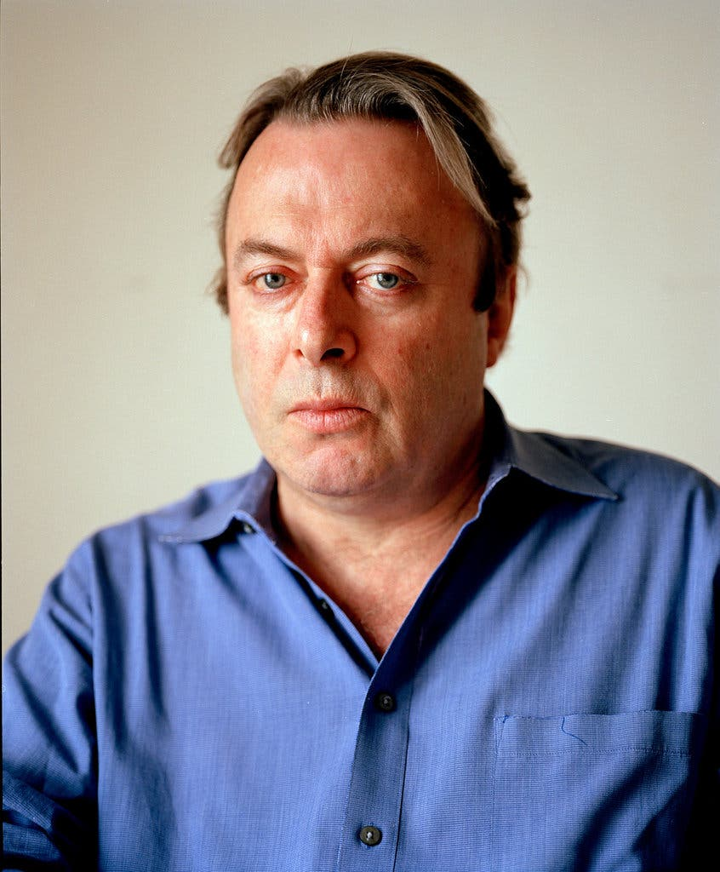
Yes I have free will;
I have no choice but to have it.
Christopher Hitchens

Slide 6
COMPARE / CONTRAST
Religion | Predestination Doctrine
Anglicanism | "Predestination to Life is the everlasting purpose of God... to deliver from curse and damnation those whom he hath chosen in Christ out of mankind, and to bring them by Christ to everlasting salvation, as vessels made to honour." (Art. 17)
Baptists | "Election is the gracious purpose of God, according to which He regenerates, justifies, sanctifies, and glorifies sinners. It is consistent with the free agency of man." (SBC)
Catholicism | Predestination to heaven only, and related to God's foreknowledge. "God predestines no one to go to hell." (Catech 1037)
Lutheranism | Predestination to heaven only. "There is no... predestination to damnation." (LCMS)
Methodism | Affirmed, but understood in terms of God choosing those he knew would freely believe
Eastern Orthodox | Seeks a middle ground between Pelagianism and Augustinian predestination. (GOAA)
Presbyterianism | "We are able to choose God because God first chose us." (PCUSA) Some modern Presbyterians are "very concerned about the few statements in the confessions" suggesting predestination to hell. (PCUSA)

Slide 7
Romans 8:28-30
And we know that all things work together for good to those who love God, to those who are the called according to His purpose.
29 For whom He foreknew, He also predestined to be conformed to the image of His Son, that He might be the firstborn among many brethren.
30 Moreover whom He predestined, these He also called; whom He called, these He also justified; and whom He justified, these He also glorified.

Slide 8
EPHESIANS 1:3-6, 11-12
…. having predestined us to adoption as sons by Jesus Christ to Himself, according to the good pleasure of His will …
… being predestined according to the purpose of Him who works all things according to the counsel of His will …

Slide 9
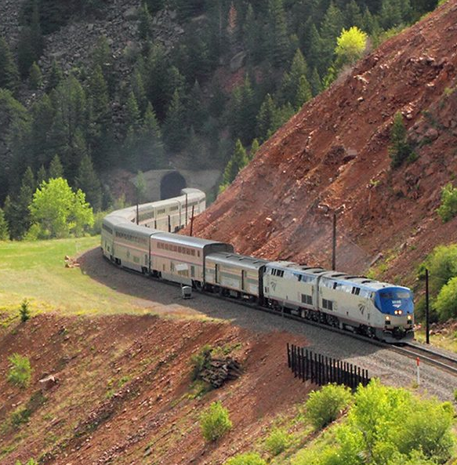
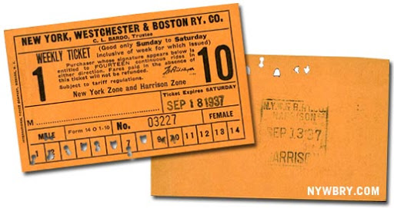

Slide 10
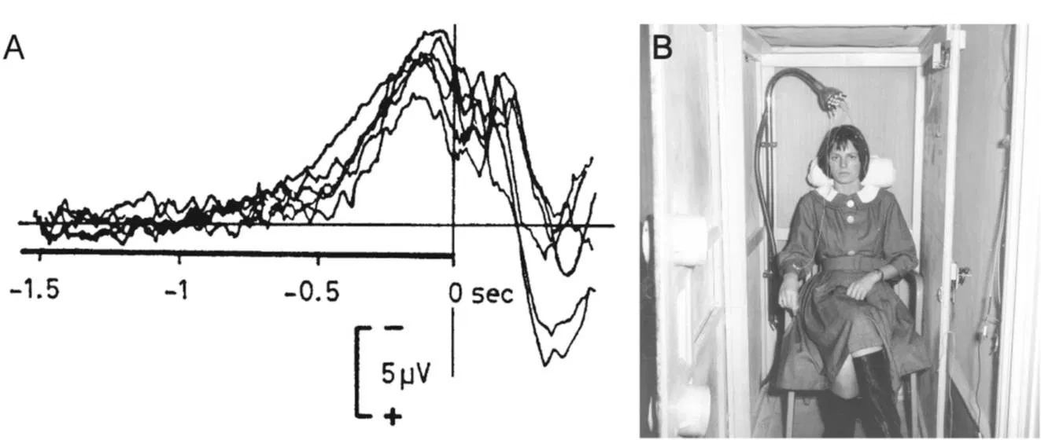
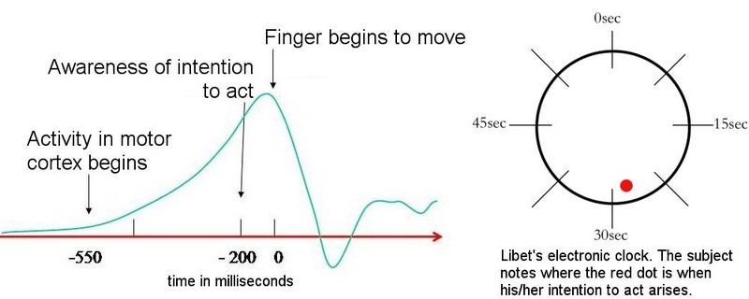
Benjamin libet

Slide 11
Jonah 3:4-10
… So the people of Nineveh believed God, proclaimed a fast, and put on sackcloth, from the greatest to the least of them …
… Then God saw their works, that they turned from their evil way; and God relented from the disaster that He had said He would bring upon them, and He did not do it …

Slide 12
#2 – Choice is built into the plan of God

Slide 13
GENESIS 3:1-6
… So when the woman saw that the tree was good for food, that it was pleasant to the eyes, and a tree desirable to make one wise, she took of its fruit and ate. She also gave to her husband with her, and he ate …

Slide 14
James 4:1-10
Where do wars and fights come from among you?

Slide 15
#3 – Consistently making positive choices takes proactive, focused effort.

Slide 16
Organ donation
% of drivers donating organs

Slide 17
Organ donor options
Check the box if you want to participate in the organ donor program
Check the box if you do not want to participate in the organ donor program

Slide 18
Philippians 4:4-8
Finally, brethren, whatever things are true, whatever things are noble, whatever things are just, whatever things are pure, whatever things are lovely, whatever things are of good report, if there is any virtue and if there is anything praiseworthy--meditate on these things.

Slide 19
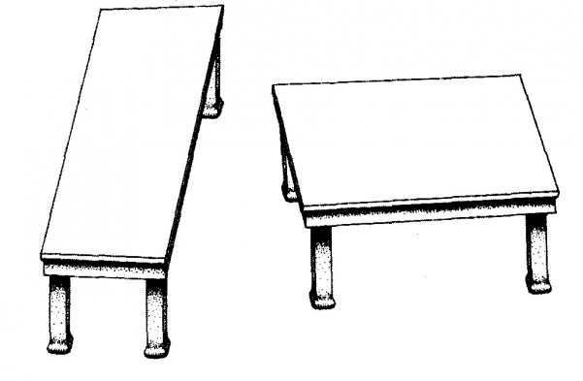
VISION TRICKS #1

Slide 20
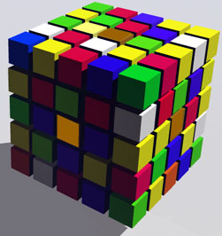
VISION TRICKS #2

Slide 21
2 Corinthians 13:5
Examine yourselves as to whether you are in the faith. Test yourselves. Do you not know yourselves, that Jesus Christ is in you? --unless indeed you are disqualified.

Slide 22
ROMANS 7:15-24
… what I will to do, that I do not practice …
… what I hate, that I do …

Slide 23
Identified the Choices
Reiterated the Purpose
Proactively Express the Decision
Stop, Reflect, Reaffirm

Slide 24
REVELATION 21:1-7
He who overcomes shall inherit all things, and I will be his God and he shall be My son.

