Slide 1
Seed Bank
Giving your life for others
Notes:
I’m not very good at memorizing scriptures. In fact, I’m not all that great on memorizing people, places, or events either. But even so, one scripture is so popular, that even people disinterested in the bible are probably familiar with it. In fact, for a long while there were whole ministries that are devoted to getting this single scripture out in the open.
It’s so popular, that some thought that if you could just get someone to look up this scripture, it might open the door to reading the bible and then eventually becoming a Christian. I’m of course, talking about John 3:16.

Slide 2

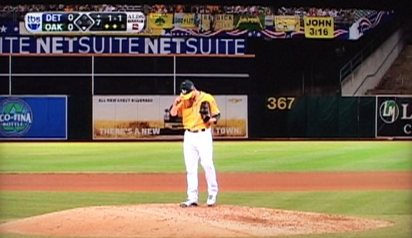
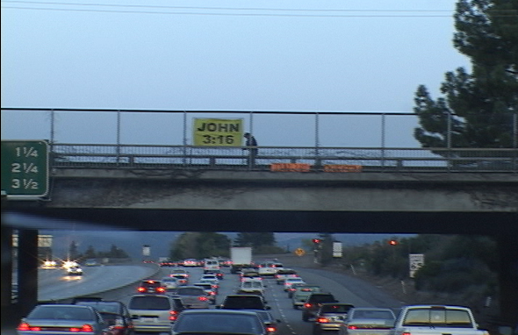
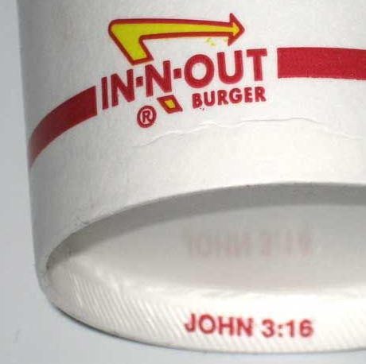
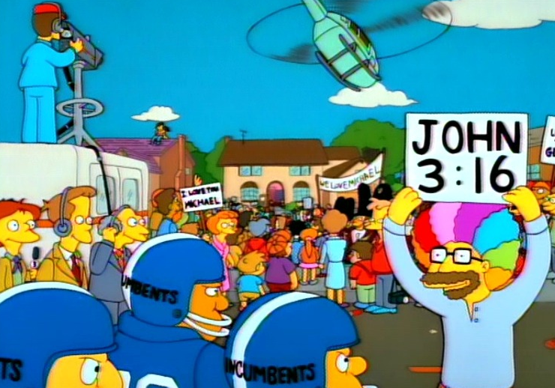
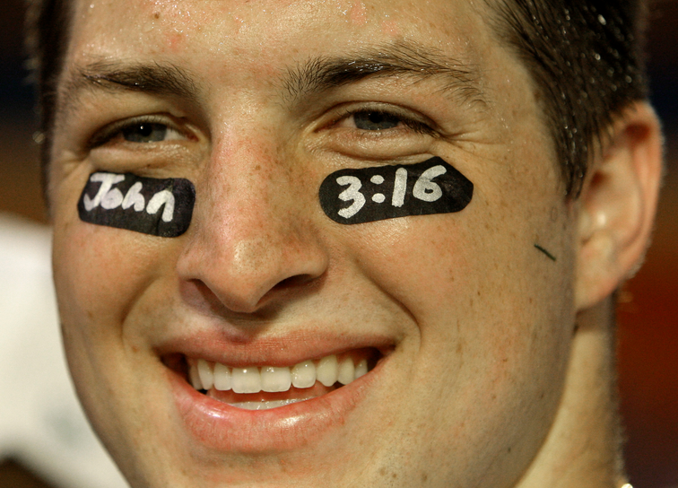
John 3:16
Notes:
For a period of time, it was everywhere – especially if you were looking for it. It was at baseball games, it was on signs on the freeway, under Tim Tebows eyeballs, even on the bottom of In And Out burger cups. It was so common that even the Simpsons parodied it.

Slide 3
John 3:16
John 3:16
John 3:16 - For God so loved the world that He gave His only begotten Son, that whoever believes in Him should not perish but have everlasting life.
Notes:
Let’s review what this scripture says – not that you don’t already know it by heart, but because it’s the launching pad for the message today.
John 3:16 "For God so loved the world that He gave His only begotten Son, that whoever believes in Him should not perish but have everlasting life.
That is a very powerful scripture, so no wonder it’s a cornerstone scripture. Really, if you were to condense the bible into just a couple of scriptures here and there – if that’s even possible, this scripture might not be the worst choice.
There is a companion scripture to this that I always think of, and that’s for obvious reason, and that’s because it’s also John 3:16, but in this case, it’s 1 John 3:16. And they often do go hand in hand as a related pair.
Let’s compare these two side by side. Again, just like for John 3:16, we are jumping into the context a bit here to pick out a single verse, but still read them together.

Slide 4
John 3:16 vs 1 John 3:16
John 3:16
1 John 3:16
John 3:16 - For God so loved the world that He gave His only begotten Son, that whoever believes in Him should not perish but have everlasting life.
1 John 3:16 - By this we know love, because He laid down His life for us. And we also ought to lay down our lives for the brethren.
Notes:
1 John 3:16 By this we know love, because He laid down His life for us. And we also ought to lay down our lives for the brethren.
You can see how these two relate. God loved the world so much, that He allowed His Son Jesus Christ to be sacrificed. Likewise, Jesus Christ Himself, also showing His love towards us, allowed Himself to be sacrificed. So if this is how they demonstrated their love towards us – we also should be willing to do the same. We also should be willing to lay down our lives for others.
Now, my question for us today is pretty straight forward. These are great scriptures to read. They are very inspiring to read. But how in the world can you possible apply them into your lives. Now, to be fair, there are stores of people in the bible, or Christians throughout time that literally fulfilled these scriptures.
And what I mean by that is those individuals, male and female, young and old – came across a situation where this exact scripture was put to the test. And they had to make a decision about what to do. To save themselves or to sacrifice themselves for the benefit of someone else or for their faith.
Maybe they put themselves in the line of fire, maybe they took in people as others were hunting them, maybe stood up in defense of someone else even through they knew it would cost them everything. And they are true heroes for doing so.
But again, what about us? Quite frankly, even if we thought we were up to the challenge, and I’m not sure I am, the opportunity doesn’t really present itself all that often now does it? We aren’t being persecuted or hunted down. We aren’t Jews during the rise of Nazi Germany. We aren’t Christians in the middle ages trying to hold ground while Islamic warriors closed in. There isn’t really a reason or opportunity to put our literal lives on the line for a cause.
So how could you possible know if you could fulfill cornerstone scriptures like the John 3:16’s in the bible.
To give some perspective on this question, I’d like to take us on a little journey and recount a secular story that might help us gain a little insight on how we can apply this principal into our lives today. And it starts right here.

Slide 5
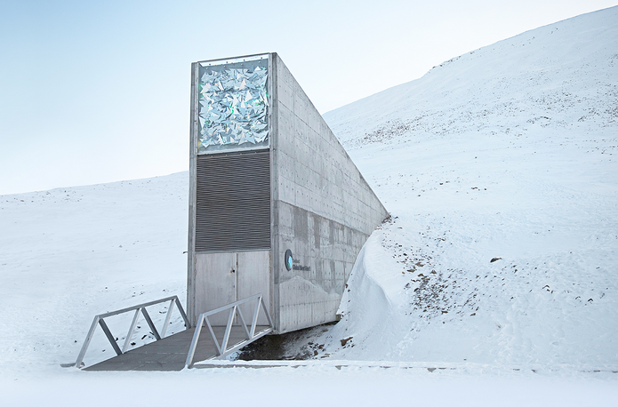
Svalbard Seed Vault
In an undisclosed location, halfway between mainland Norway and the North Pole, lies the Global Seed Vault
Notes:
Actually, I think it’s better to say that the story ENDs right here. Does anyone recognize this picture? Has anyone been to this place before? Does anyone think this would be a relaxing tourist destination?
This is the Svalbard Seed Vault. A seed vault is a storage unit of seeds. This one is the largest collection of seeds found in the entire world, and frankly, no other seed vault comes anywhere close. It has almost a million individual varieties of crops currently and it’s built to house over 4 billion. It has crop samples for almost every country in the world. It’s specifically designed with numerous safe guards so it can withstand just about any threat. And, if there ever happens to be a catastrophic event on the earth and large amounts of crops die out, then nations can come to this vault and withdraw seeds from every major crop and start growing them once more.

Slide 6
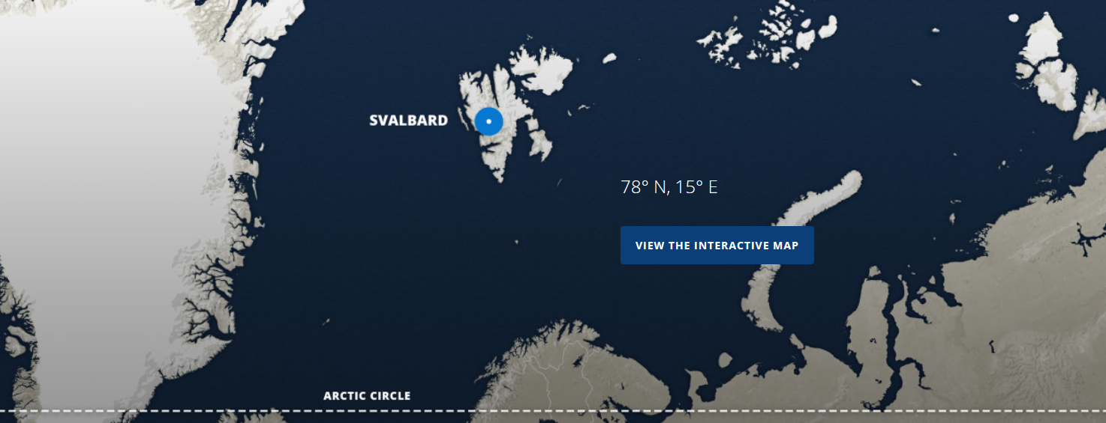
Seed Vault
Largest collection of crop diversity on the planet
Notes:
And as you can see, it’s literally in the middle of nowhere. It’s the furthest north you can fly on a scheduled flight. The vault entrance itself it barely visible on the surface, but the actual vault is buried deep underground in permafrost. It’s so close to the North Pole, that even if the vault lost all power and the multiple backups failed for some reason, the natural temperature is close enough to keep the seeds frozen. It’s an incredible achievement and often listed as one of the rare instances of every major country working together.
Well, what does this have to do with us today?
Before we got to this large seed vault, you had to start with smaller regional seed banks. And to get to that point, you need this guy.

Slide 7
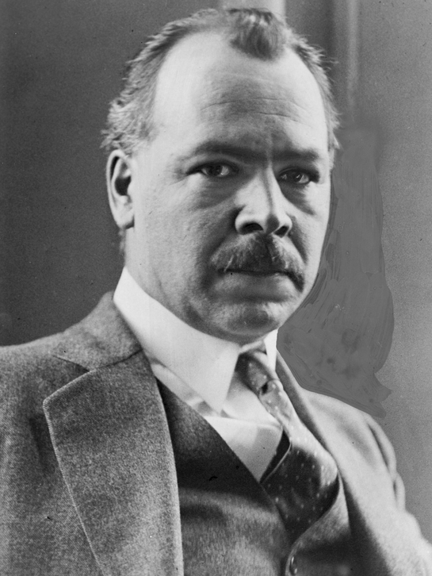
Nikolai Vavilov
Born: November 25, 1887
Died: January 26, 1943
Prominent Russian and Soviet agronomist, botanist and geneticist
Notes:
Because the modern-day seed vaults today originate with basically with one man during World War 2. His name was Nikolay Vavilov (VAV A LOFT) and he lived in what was then the Soviet Union. This man grew up during some intense famines in eastern Europe and he was determined to never let them happen again. As a result, he started his work as a botanist during the 1920s. During this time, he had a novel idea: maybe collecting seeds and understanding crop diversity across the world, one could help fight off crop failures and prevent famines.
He was one of the first people to understand how plants can be adapted to different climates and conditions by selective cross breeding. And so he started collecting seeds. Lots of seeds. Vavilov and his team started doing these expeditions, more than a hundred in total, across the world collecting seeds from 64 countries.
But as his work grew, so did his distractors. And this being the time frame of World War Two and one of those detractors being the Soviet Union leadership – he and his team were thrown into a prison complex in Leningrad or what is now St. Petersburg. He and his team were separated and held for some time. Vavilov was held in a prison in died of starvation.
His staff did not fair much better. They were held in a single building. In the basement was the prized seed bank – which at that time contained Vavilov’s 220k seeds, but also 150k from other collectors. And while the army took every else of value from the building, they did not check the basement for whatever reason and did not find the seeds.
Now, if that’s where the story ended, that wouldn’t very helpful in our quest to better understand John 3:16.
But you see, there is more to the story. While they were in prison, Leningrad was under siege. There was no food anywhere. I mean anywhere. People were starving everywhere where starving. Vavilov’s team locked themselves in the building and took turns guarding the seeds.
But as the siege wore on, they had a difficult decision to make. There was simply no food left. Here, they were protecting seeds for the future – but they could also use them right now. Was the cause that they fought for worth it? Was a giant collection of seeds worth their lives?
12 scientists, a good portion of the team, starved to death guarding the seed. One, an individual specifically in charge of rice seeds, died within a few feet of thousands of packets of rice. All he had to do was add to water and cook the rice and his life would have been saved.
Not one of the seeds in the collection was eaten during the siege.
While 12 did die, a few members of the team did survive. A biography wrote of one of the survivors:

Slide 8
One of them said it was hard to wake up, it was hard to get on your feet and put on your clothes in the morning, but no, it was not hard to protect the seeds once you had your wits about you. Saving those seeds for future generations and helping the world recover after war was more important than a single person's comfort.”
Vavilov’s team of seed bank scientists.
Notes:
“One of them said it was hard to wake up, it was hard to get on your feet and put on your clothes in the morning, but no, it was not hard to protect the seeds once you had your wits about you. Saving those seeds for future generations and helping the world recover after war was more important than a single person's comfort.”
Some of the team did survive the siege and the war. And so did the seeds. And the Svalbard vault is a direct descendant of their work.
These individuals did have a chance to put their lives on the line for a cause that was important to them. But more importantly to our point today, they also had built their lives for years prior in focus of a single goal.
In Hebrews chapter 11, you don’t need to turn back there, we have a huge list of people that faced this test and passed. Giant characters of the bible rising to the occasion. Individuals that took the example of the seed bank scientists to the next level, and when their lives where on the line, they fully committed to principal found in the John 3:16s of the bible.

Slide 9
Heb 12:1-2
Heb 12:1-2 - Therefore we also, since we are surrounded by so great a cloud of witnesses, let us lay aside every weight, and the sin which so easily ensnares us, and let us run with endurance the race that is set before us, looking unto Jesus, the author and finisher of our faith, who for the joy that was set before Him endured the cross, despising the shame, and has sat down at the right hand of the throne of God.
Notes:
But let’s notice a comment in Hebrews chapter 12, verses 1 and 2.
Heb 12:1 – Therefore [meaning considering the examples found in the previous faith chapter] we also, since we are surrounded by so great a cloud of witnesses, let us lay aside every weight, and the sin which so easily ensnares us, and let us run with endurance the race that is set before us,
2 looking unto Jesus, the author and finisher of our faith, who for the joy that was set before Him endured the cross, despising the shame, and has sat down at the right hand of the throne of God.
We may or may not ever have to face a dire challenge where our lives are put on the line. But all of us, each and every one of us, are required to lay the groundwork now. To train and prepare our lives today. When the scientists in the basement of a prison building faced starvation, it was a natural extension of what they had already been preparing their lives for. Their professional careers and their livelihoods were single focused into that goal. And when the ultimate challenge arose, they were well prepared. In a similar manner, let us train ourselves and our livelihoods into a single focused goal. That way, if an ultimate challenge ever arises for us – we will be likewise prepared.

