Slide 1
Perspectives of 4/3
Multiple Ways of Looking at the Same Thing

Slide 2
What is 4/3?
4
3

Slide 3
Representation of 4/3
4
3

Slide 4
Decimals of 4/3
1.333333333…
10
1.010101010…
4
2
1.111111111…
4
1.131313131…
3
5
1.222222222…
7
1.252525252…
8

Slide 5
Graphical 4/3
4
3

Slide 6
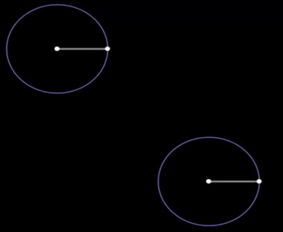
Plotting 4/3, v1
4
3

Slide 7
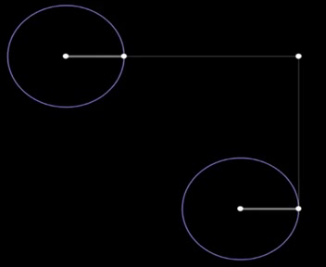
Plotting 4/3, v2
4
3

Slide 8
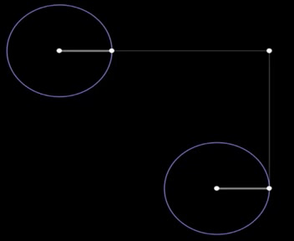
Plotting 4/3, v3
4
3

Slide 9

Sound of 4/3
2
4
3/2
4/3
3
1
1
1

Slide 10
Rhythm of 4/3
4
3

Slide 11
What is 4/3?
…. depends on your perspective

